Slide 1
Tiny Hacking Agents + ReAct Prompting!

Slide 2
Chains vs Agents? What is what again?
Question
Prompt
LLM
(With Tools)
Output-Parser
Output
Chains
Agents
Question
Prompt
LLM
(With Tools)
Output-Parser
Output

Slide 3
Chains vs Agents? What is what again?
Question
Prompt
LLM
(With Tools)
Output-Parser
Output
Problems/Challenges with agents
Why do they make decisions?
They can lose track of what they already did and keep looping to research the question they were asked.
They can use too little tools, or way too many.
Solution
Good Prompting!

Slide 4
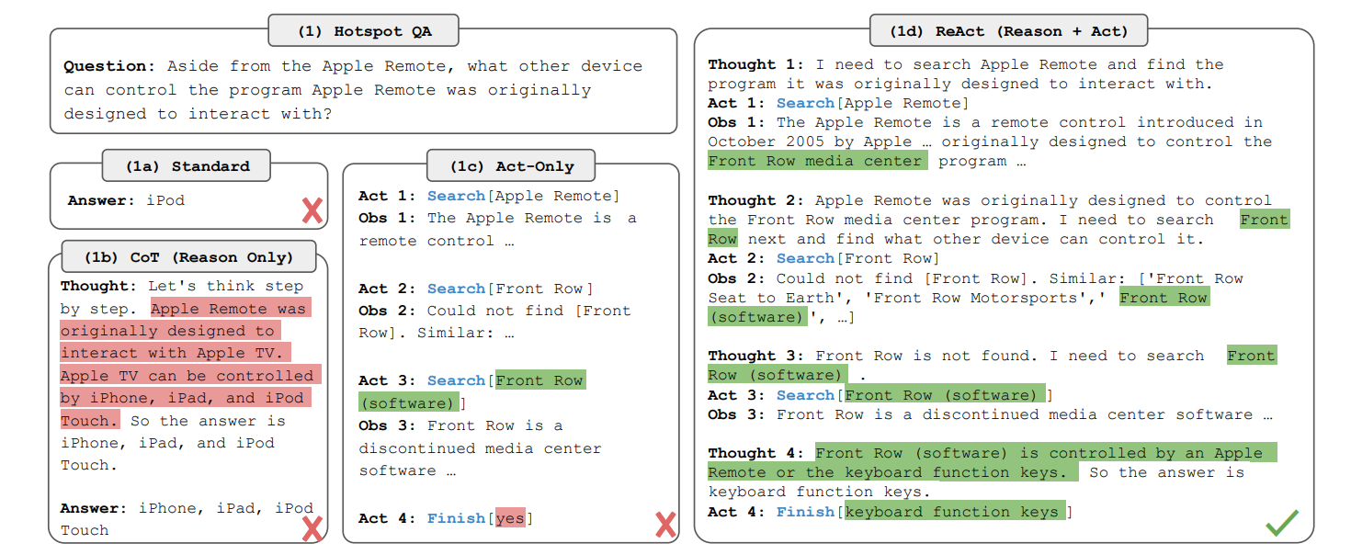
Basic Prompting, Chain-of-thought Prompting, and ReAct Prompting
2210.03629 (arxiv.org)

